Slide 1

The four Cs of effective classroom teaching
Charles Sturt University L&T Symposium
2 September 2021
@sutherka

Slide 2
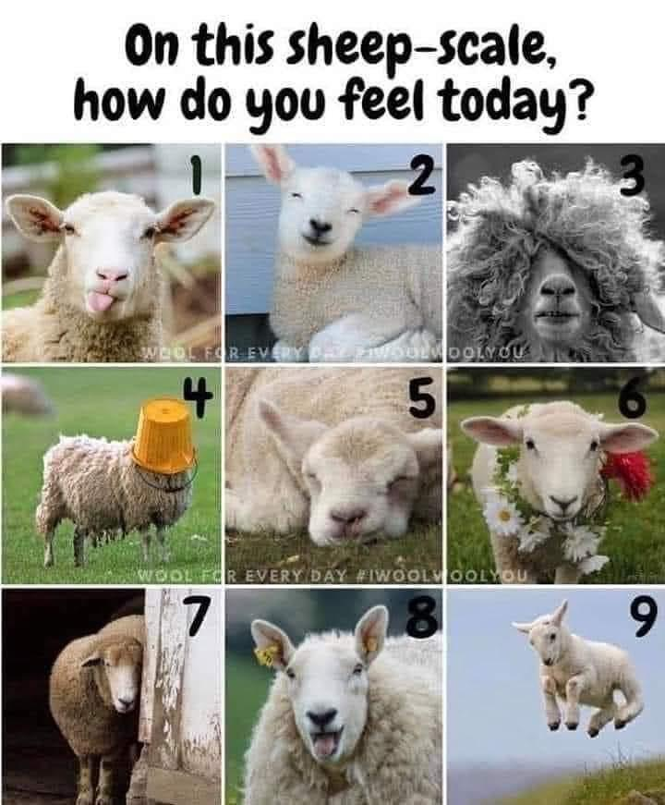
https://samanthawan.com.au/2020/08/22/sheep-scale-meme/

Slide 3
What might the four Cs be?
Use the chat to suggest some words starting with ‘c’ that might be important for effective classroom teaching

Slide 4
Cognitive Challenges of Effective Teaching
Chew & Cerbin (2021)
Student mental mindset
Metacognition and self-regulation
Student fear and mistrust
Insufficient prior knowledge
Misconceptions
Ineffective learning strategies
Transfer of learning
Constraints of selective attention
Constraints of mental effort and working memory

Slide 5
The four Cs of effective classroom teaching
Sutherland (2021)
Connect
Communicate
Collaborate
Consolidate

Slide 6
Connect
Be interested and be inclusive
Know your students (names, pronouns, inclusive examples)
Be prepared
Know your course (and its connections)

Slide 7
Communicate
Be selective (about content)
Be organised (with content and structure)
Be clear (always use a mike!)

Slide 8
Collaborate
Be engaging
Wait more than 2.5 seconds
Be empowering
Listen
Ask questions
Be deliberate
Opportunities before & after class

Slide 9
Consolidate
PAUSE and reflect

Slide 10
 | Focus | Ask learners to…
P | Prepare notes | Check their notes and fill in any gaps, note questions, highlight things to return to later Compare notes with their neighbour
A | Ask or answer questions | Write down a question they have, then ask it of each other or of you Answer a question (with time to formulate their answer) Complete a quiz or poll
U | Use ideas | Write down how they are going to apply what they’ve learned today Use today’s key ideas to connect with what they are learning in another subject
S | Sequence, symbolise, summarise, synthesise or solve | Draw the key concepts in a mind map Make a flow chart Summarise in three bullet points max Draw a picture that symbolises key ideas Synthesise lecture points into a diagram Solve a problem
E | Explain | Put the key ideas of the last 15 minutes into terms a 10-year-old could understand Explain to their neighbour what they believe is true (when presented with conflicting ideas)

Slide 11
PAUSE
What are you doing or planning to do that will:
Prepare students to CONNECT with content, each other, and you
Ensure you COMMUNICATE with clarity and in an organised way
Enable students to COLLABORATE on ideas, skills and content that engages and empowers them, and
Create reflective pause moments for students to CONSOLIDATE what they learn?

Slide 12
References
Chew, S.L & Cerbin, W.J. (2021). The cognitive challenges of effective teaching. The Journal of Economic Education, 52(1), 17-40. https://doi.org/10.1080/00220485.2020.1845266
Cho, YH., Lee, SY., Jeong, DW., Im, SJ., Choi, EJ., Lee, SH., Baek, SY., Kim, YJ., Lee, JG., Yi, YH., Bae, MJ., & Yune, SJ (2012). Analysis of questioning technique during classes in medical Education. BMC Medical Education, 12, Article number 39. https://bmcmededuc.biomedcentral.com/articles/10.1186/1472-6920-12-39
Nilson, L. (2016). Teaching at its best: A research-based resource for college instructors. 4th edn. San Francisco: Jossey Bass.
Sutherland, K.A. (2021). The four Cs of effective classroom teaching. pp. 112-134 in L.Hunt & D. Chalmers (eds.). University Teaching in Focus. 2nd ed. Routledge. www.routledge.com/9780367442101

